Slide 1
ZS Data Science Hiring
9 -13 February 2018

Slide 2
Submission Details
The final submission should consist of 3 parts:
Section A – Approach document (Submission file format : PPT/XLSX/DOC)
Section B – Supporting codes for final submission (Submission file format: Any programming language)
Section C – Model prediction (Submission file format: *.csv)
[
Any submission not having all 3 components will be considered as incomplete submission
Notes:
What could be the potential reasons for non-consistency; Which data is required to answer the company concern.

Slide 3
Submitting “Section A”
In Section A, please provide your findings and justification on the below topics -
A 250-word write-up outlining your approach towards the problem statement (Word Document)
Quality checks performed / Errors found: Please report any potential errors / inaccuracies in the training dataset
Data preprocessing steps: Please provide potential data aggregations / transformations performed including how the quality checks from section 1 are dealt with
Feature generation: Please provide list of features that were created and share the how and why the feature was created
Key observations / Trends: Please provide any information on your key observations / insights / trends that you may gleaned from the datasets
Model choice explanation: Please justify the usage of a particular model for the dataset provided. This should ideally include the reasoning and comparison justifying the choice
Expected error for submission: please provide the expected error for submission file in Section C
Top 5 most significant variables in model: please provide the most significant feature in the dataset and how were they determined
Please submit your thoughts in word/PPT/Excel on the portal
The above list is for directional purposes. Please include other findings identified while solving case

Slide 4
Submitting “Section B”
Please submit the source code for the training and prediction
Upload a zip file (max allowed size is 2MB)
The submitted file must have a README file with a detailed description about how to run the model to predict the dependent variable and generate the <userID>.csv file.
There is no limit on execution time, but the code should generate the output file:<UserID>.csv
Please ensure that the submitted code files are well-commented and structured for easy comprehension

Slide 5
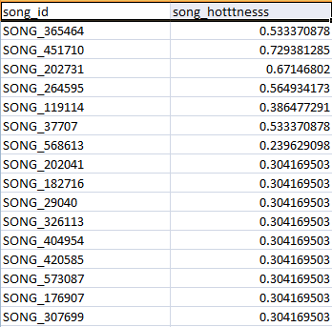
Submitting “Section C”
Create new submission file containing “song_id” from test set and “song_hotttnesss” column for each ID (see below table for details)
Predictions for the submission dataset are to be submitted via “My Submission” page on the ZS YDS web platform
Note:
In case you face any error while submitting the model prediction for evaluation even after following the submission format, share the following with your query:
Snapshot of the error faced
Submission csv file
Evaluation Engine consider only .csv file in the abovementioned format as a valid submission.
In case of any submission related errors, please reach out to the support team at
Silky.sethi@zs.com

